Slide 1
Cystic Fibrosis Disease
Here is where your presentation begins

Slide 2
Contents of this template
Here’s what you’ll find in this Slidesgo template:
A slide structure based on a medical disease presentation, which you can easily adapt to your needs. For more info on how to edit the template, please visit Slidesgo School or read our FAQs.
An assortment of graphic resources that are suitable for use in the presentation can be found in the alternative resources slide.
A thanks slide, which you must keep so that proper credits for our design are given.
A resources slide, where you’ll find links to all the elements used in the template.
Instructions for use.
Final slides with:
The fonts and colors used in the template.
A selection of illustrations. You can also customize and animate them as you wish with the online editor. Visit Storyset to find more.
More infographic resources, whose size and color can be edited.
Sets of customizable icons of the following themes: general, business, avatar, creative process, education, help & support, medical, nature, performing arts, SEO & marketing, and teamwork.
You can delete this slide when you’re done editing the presentation.

Slide 3
Table of contents
1
2
3
4
5
6
About the disease
Diagnosis
Recommendations
Here you could describe the topic of the section
Here you could describe the topic of the section
Here you could describe the topic of the section
Pathology
Treatment
Conclusions
Here you could describe the topic of the section
Here you could describe the topic of the section
Here you could describe the topic of the section

Slide 4
Introduction
It could be the part of the presentation where you can introduce yourself. Keep it short and go straight to the point. Your audience will it

Slide 5
1
About the disease
You can enter a subtitle here if you need it

Slide 6
About the disease
Mars
Jupiter
Saturn
Despite being red, Mars is a cold place, not hot at all
It’s a gas giant and the
biggest planet in the Solar System
Yes, this is the ringed planet. It’s a gas giant, composed of helium

Slide 7
About the disease
Mars
Mercury
Despite being red, Mars is a cold place
Mercury is the smallest planet of them all
Jupiter
Venus
Jupiter is the biggest planet of them all
Venus has a beautiful name, but it’s hot

Slide 8
Concepts and typology
Type A
Type B
Gestational
Mercury is the smallest planet of them all
Venus has a beautiful name, but it’s very hot
Yes, this is the ringed planet. It’s a gas giant

Slide 9
Pathology
Mercury is the closest planet to the Sun, but does its name have
anything to do with the liquid metal?
Mercury
Mars
Mercury is the closest planet to the Sun
Despite being red, Mars is a cold place
Venus
Saturn
Venus has a beautiful name, but it’s very hot
Yes, this is the ringed planet. It’s a gas giant

Slide 10
Symptoms of the disease
Recurrent sinusitis
Venus has a beautiful name
Lung infections
Despite being red, Mars is cold
Exercise intolerance
Jupiter is the biggest planet

Slide 11
1,039,485
Big numbers catch your audience’s attention

Slide 12
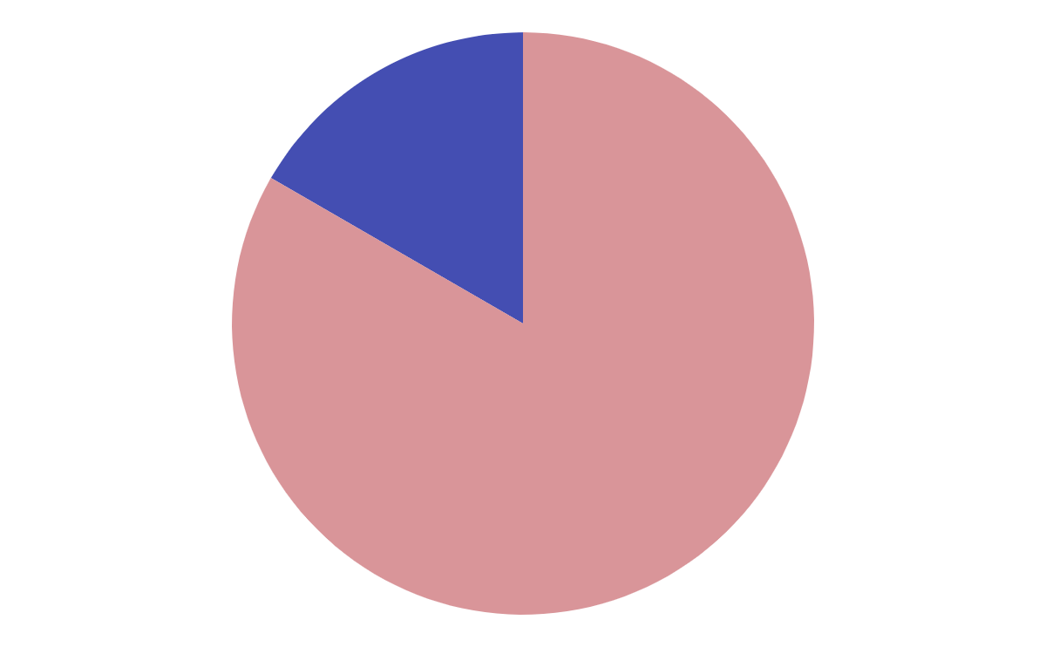
Risk factors
Mars
16.7%
Despite being red, Mars is a cold place
Mercury
83.3%
It is the closest planet to the Sun
If you want to modify this graph, click on it, follow the link, change the data and replace it

Slide 13
Key numbers
50,000
20,000
5,000
Venus has a beautiful name
Despite being red, Mars is cold
Jupiter is the biggest planet

Slide 14
Lung transplant
2.5%
1%
Patients received a lung transplant for cystic fibrosis and other conditions
Total percentage of hospitals that offer lung transplant

Slide 15
—Someone famous
“This is a quote. Words full of wisdom that someone important said and can make the reader get inspired”

Slide 16
Diagnosis
Mercury
Venus
Mars
Mercury is the closest planet to the Sun
Venus has a beautiful name, but it’s very hot
Despite being red, Mars is a cold place
Saturn
Jupiter
Neptune
Yes, this is the ringed planet. It’s a gas giant
It’s the biggest planet in the Solar System
It’s the farthest planet from the Sun of them all

Slide 17
Prevention
 | Doctor checking | Blood testing | Genetic testing
Every month | ✔ | - | -
Every year | - | ✔ | -
Once | - | - | ✔

Slide 18
Treatment
1
2
3
4
Saturn is composed mostly of hydrogen
Earth is the planet we all live on
Despite being red, Mars is a cold place
Venus has a beautiful name, but it’s very hot

Slide 19
Recommendations
Here you can describe what the patient shouldn’t do
Here you can describe what the patient shouldn’t do
Here you can describe what the patient shouldn’t do
Here you can describe what the patient should do
Here you can describe what the patient should do
Here you can describe what the patient should do

Slide 20
Prevalence
Mercury
Mercury is the closest planet to the Sun and the smallest of them all
Jupiter
It’s a gas giant and the biggest planet in the Solar System

Slide 21
Conclusions
Transplant is improving the future for people with cystic fibrosis
You can replace the image on the screen with your own work. Just delete this one, add yours and center it properly

Slide 22
Transplant is improving
1
+
2
Sequential method
Simultaneous method
Mercury is the closest planet to the Sun and the smallest one in the Solar System
Venus has a beautiful name and is the second planet from the Sun

Slide 23
Our team
J. James
J. Doe
J. Patterson
J. John
Here you can talk a bit about this person
Here you can talk a bit about this person
Here you can talk a bit about this person
Here you can talk a bit about this person

Slide 24

Sneak Peek
You can replace the image on the screen with your own work. Just delete this one, add yours and send it to the back

Slide 25
References
AUTHOR (YEAR). Title of the publication. Publisher
AUTHOR (YEAR). Title of the publication. Publisher
AUTHOR (YEAR). Title of the publication. Publisher
AUTHOR (YEAR). Title of the publication. Publisher
AUTHOR (YEAR). Title of the publication. Publisher
AUTHOR (YEAR). Title of the publication. Publisher

Slide 26
Thanks
Does anyone have any questions?
addyouremail@freepik.com
+91 620 421 838
yourcompany.com
Please keep this slide for attribution

